Slide 1
October is…

Slide 2
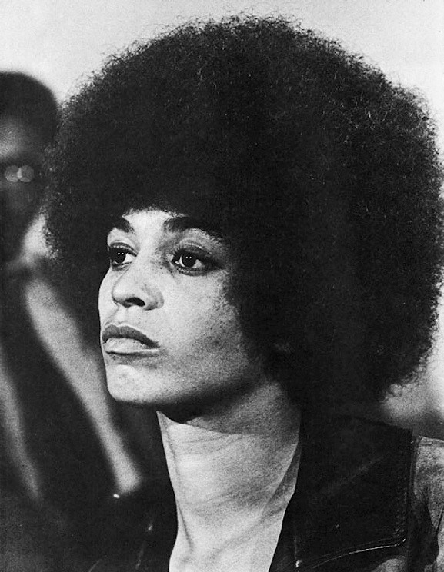
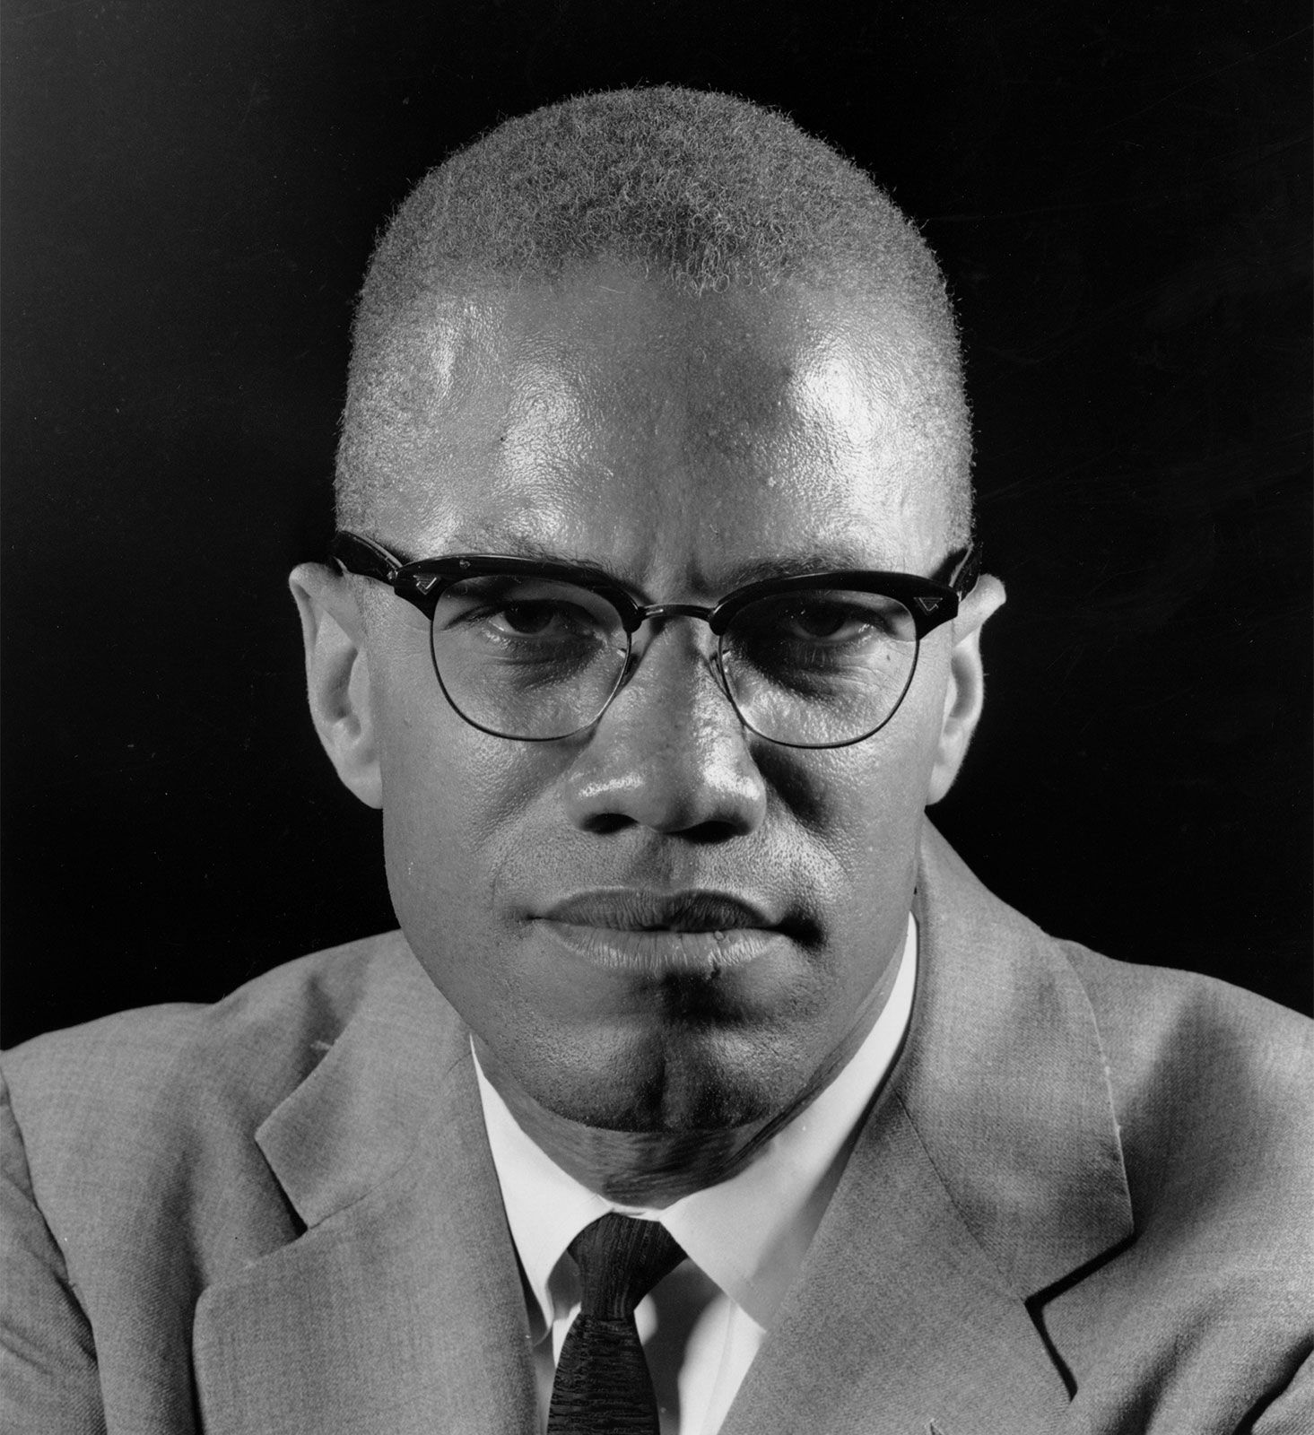
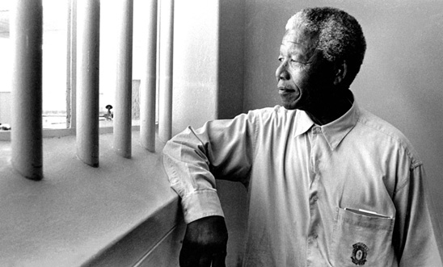
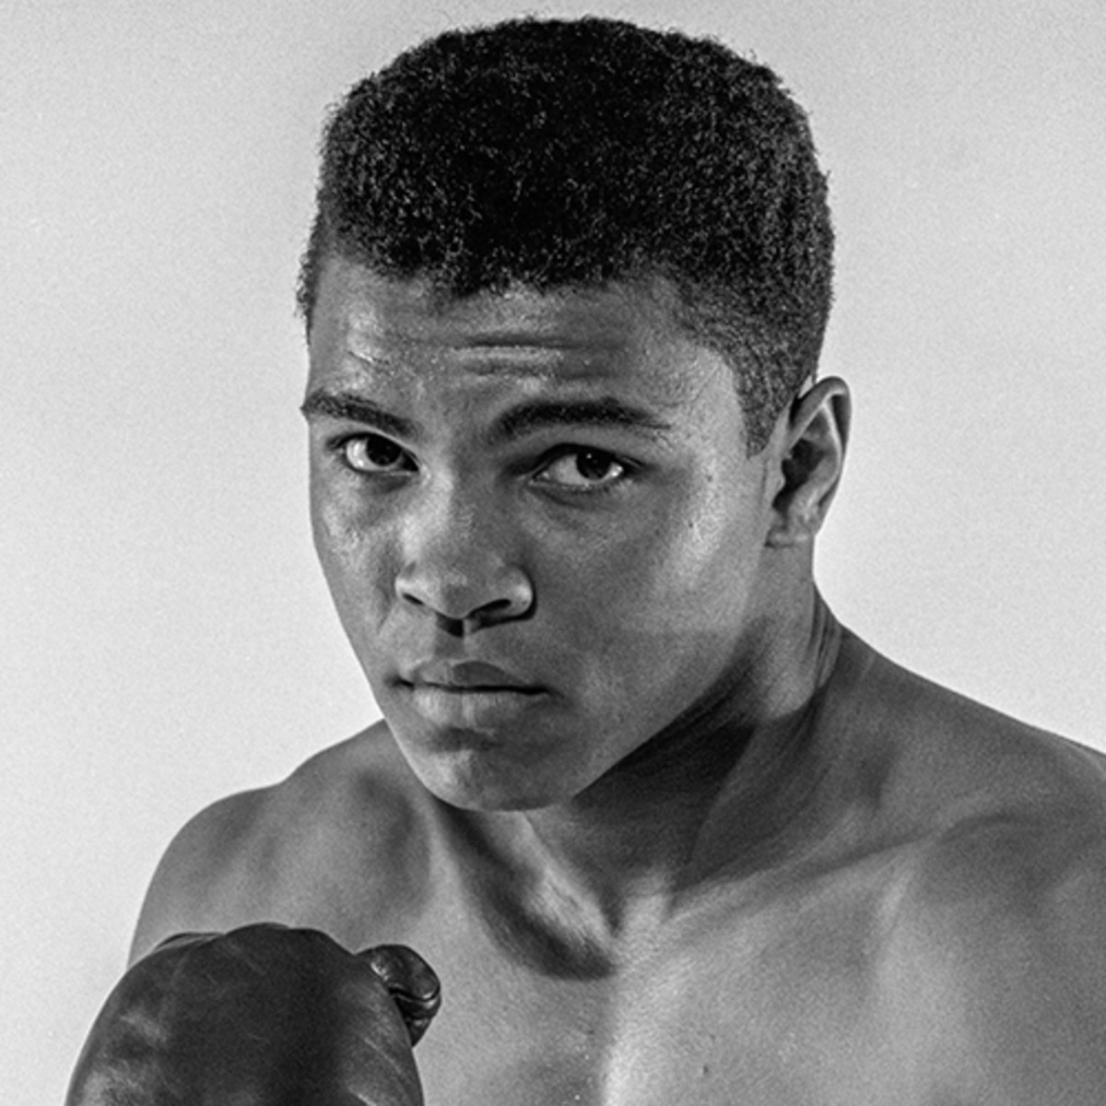
Can you name these people and where they are from?

Slide 3
Can you name these people and where they are from?
Malcolm X - USA
Angela Davis - USA
Martin Luther King Jr - USA
Nelson Mandela – South Africa
Muhammed Ali - USA

Slide 4
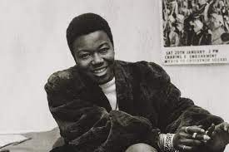
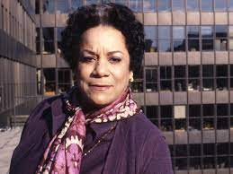
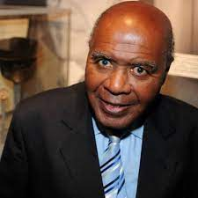
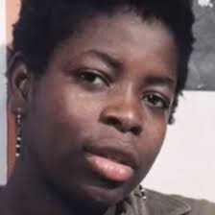
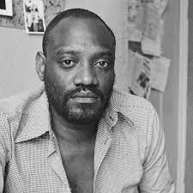
Can you name these people and where they are from?

Slide 5
Can you name these people and where they are from?
Olive Morris - UK
Jocelyn Barrow - UK
Paul Stephenson - UK
Altheia Jones – Le Cointe – Trinidad and Tobago / UK
Darcus Howe - UK

Slide 6
This year we will focus on black British Civil Rights leaders…
In the assembly presentation you can find further information about these black British Civil Rights leaders.
Video clips will highlight their impact and bravery.
Please use our BHM reading list.
There are a wealth of opportunities to find out more about these inspirational Civil Rights leaders in our resources.
Watch these clips for a flavour of what is to come:
https://www.youtube.com/watch?v=-qeMgSVViHc
https://www.youtube.com/watch?v=qFjTbXf-u2k
https://www.youtube.com/watch?v=7SsprpsHSdU

