Slide 1
October is…

Slide 2
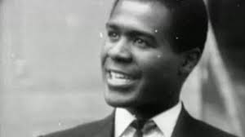
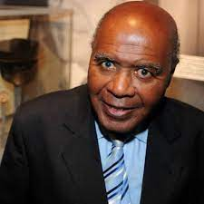
Who was Paul Stephenson…
The clips below highlight his achievements.
Please watch clips 1 and 2 and clip 3 is an extra bonus clip:
1) https://www.youtube.com/watch?v=uSyzaXXKUaQ
2) https://www.youtube.com/watch?v=-0eR7dH7BYY
3) https://www.youtube.com/watch?v=Nht6pyQFQ40
There is additional information about Paul Stephenson on the assembly presentation.

Slide 3
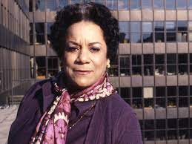
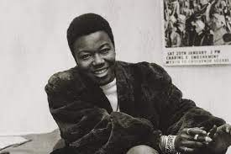
Who were Jocelyn Barrow and Olive Morris…
Jocelyn Barrow
Olive Morris
Watch this clip about how Jocelyn Barrow fought for employment rights for black people in Marks and Spencer:
https://www.youtube.com/watch?v=vRo02yOmWk8&t=2s
Watch this clip about how Olive Morris helped to change this country:
https://www.youtube.com/watch?v=ZfcEepuEjHY

