Slide 1
October is…

Slide 2
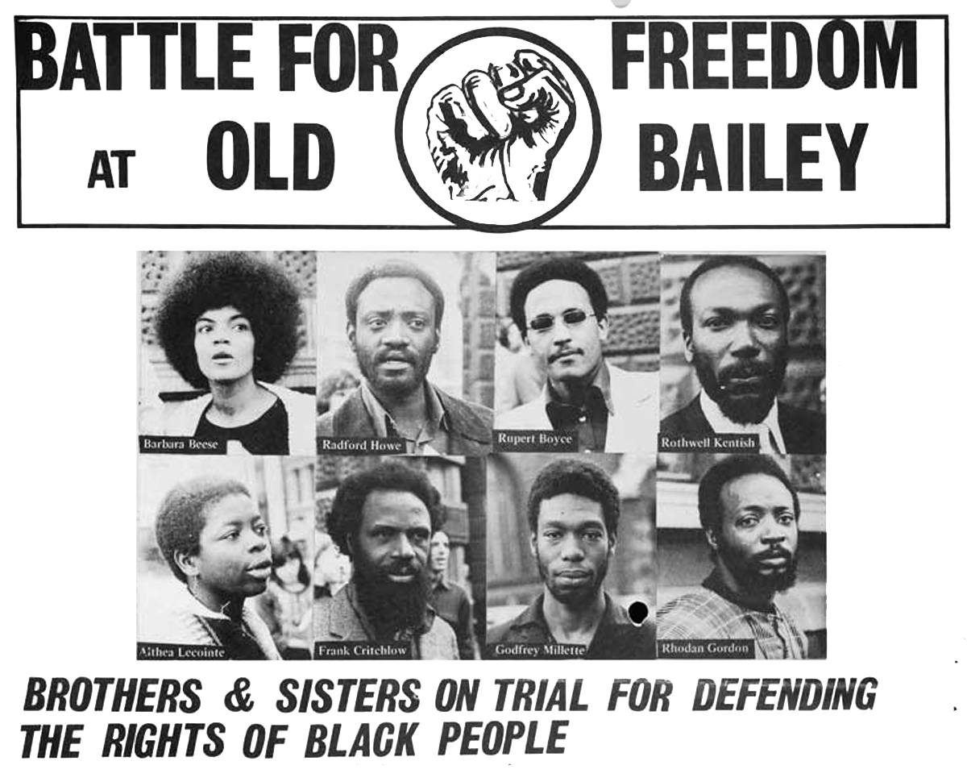
The Mangrove Nine:
What happened?
Many Windrush migrants called Notting Hill, in London, home between 1949-1971.
In 1968 Frank Crichlow, a Trinidadian, opened a restaurant called the Mangrove. It served spicy West Indian food and was an instant success.
Jimi Hendrix, Diana Ross, Marvin Gaye and Bob Marley all dined at the Mangrove. It became a hub for the black community.
Over the next year or two the Mangrove was repeatedly raided by the police and had its night café license revoked. No evidence of criminal activity was ever found. Frank and his customers were law abiding citizens.
The Black Panther movement came to Frank’s aid. On August 9th 1970 a crowd gathered outside the Mangrove. A peaceful protest ended with 24 police officers injured and 19 arrests.
Watch this trailer for ‘Mangrove’ to get a flavour of the protest.
https://www.youtube.com/watch?v=VHFLv3k2Eww

Slide 3
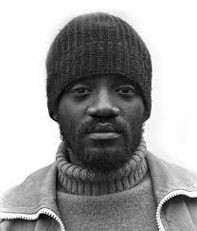
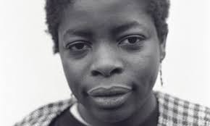
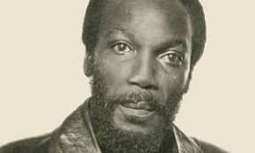
The Mangrove Nine Trial:
On August 9th 1970 a crowd gathered outside the Mangrove. A peaceful protest ended with 24 police officers injured and 19 arrests.
Nine individuals, including Frank Crichlow, Darcus Howe and Altheia Jones – Le Cointe, were arrested for incitement to riot.
At first the charges were dismissed through lack of evidence and because police reports were contradictory.
But the protesters had allegedly been heard shouting ‘Kill the Pigs’. The charges were reinstated as prosecutors said these words were evidence of violence. They were all rearrested.
Darcus and Altheia took the bold decision to defend themselves in court. This meant they could speak directly to the jury. The prospect of black people defending themselves in court increased media attention.
All defendants were cleared of the main charges to incite a riot. Four received suspended sentences for lesser offences.
The case made legal history as it delivered the first judicial acknowledgment of racial hatred in the Metropolitan Police.
The case also marked a major milestone in the fight for Civil Rights in Great Britain.
Darcus Howe,
Altheia Jones – Le Cointe
and Frank Crichlow
Watch the director and actors of ‘Mangrove’ discuss the Mangrove Nine
https://www.youtube.com/watch?v=m_jqkYtfGQ8&t=205s

Slide 4
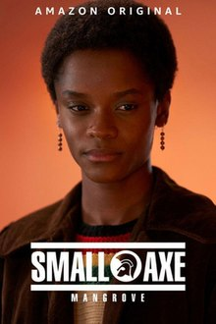
An in depth BBC article about the Mangrove Nine can be found here.
https://www.bbc.co.uk/news/extra/jGD9WJrVXf/the-mangrove-nine-black-lives-matter
Mangrove can be found now on BBC Iplayer. The two hour episode tells the story of the Mangrove Nine. It does contain some offensive language.
‘Mangrove’ is part of a larger series by director Steve Mcqueen. The series tells many stories of black resistance/excellence. The series is called Small Axe. All episodes are available on Iplayer and all episodes are rated 15.

